Slide 1
Shiny - Part 2

Slide 2
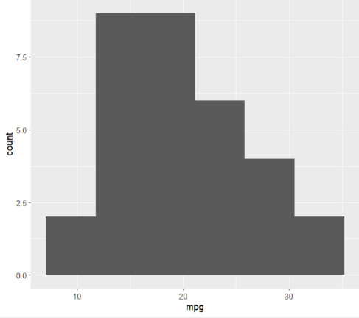
plot_1 <- mtcars %>%
ggplot(aes(x = mpg)) +
geom_histogram(bins = 6)
plot_1

Slide 3
Shiny App – Skeleton

Slide 4
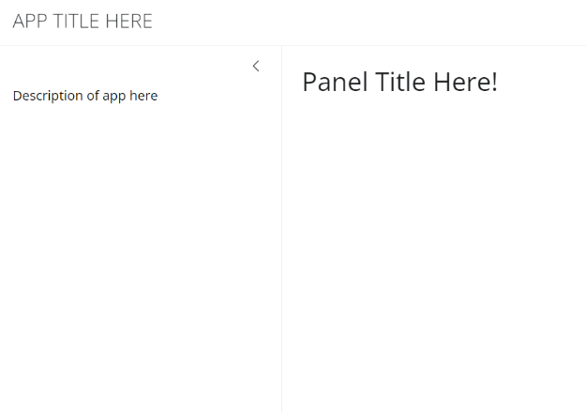
library(shiny)
library(bslib)
# Define user interface
ui <- page_sidebar(
# App title
title = "APP TITLE HERE",
# Sidebar
sidebar = sidebar(
width = 350,
"Description of app here",
# Widget code here
),

Slide 5
# Main Panel
titlePanel("Panel Title Here!"),
plotOutput(outputId = "display_plot")
)
# Define server logic
server <- function(input, output) {
output$display_plot <- renderPlot({
})
}
# Run the app
shinyApp(ui = ui, server = server)

Slide 6
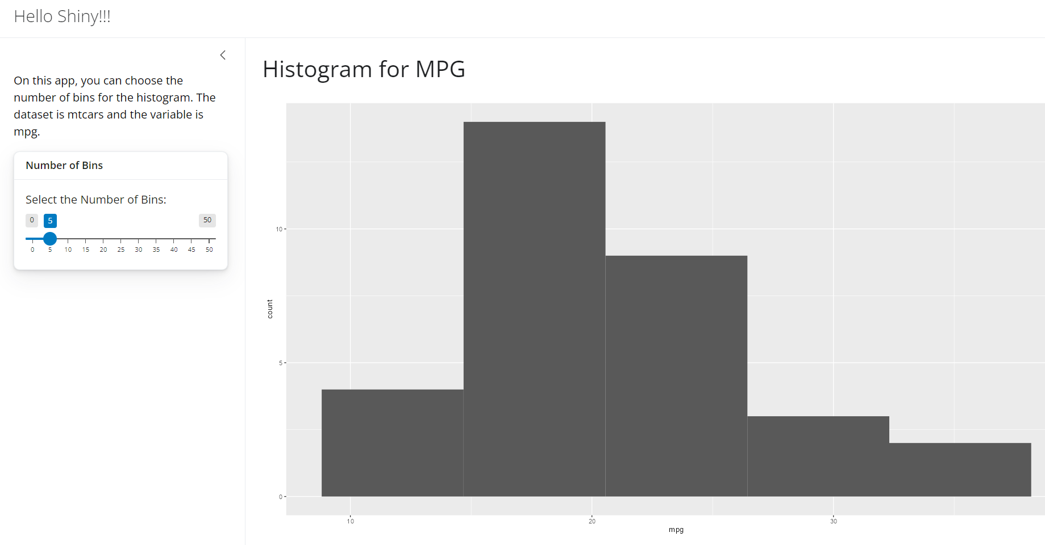
To Recreate 1
File Name: shiny_app_histogram_1

Slide 7
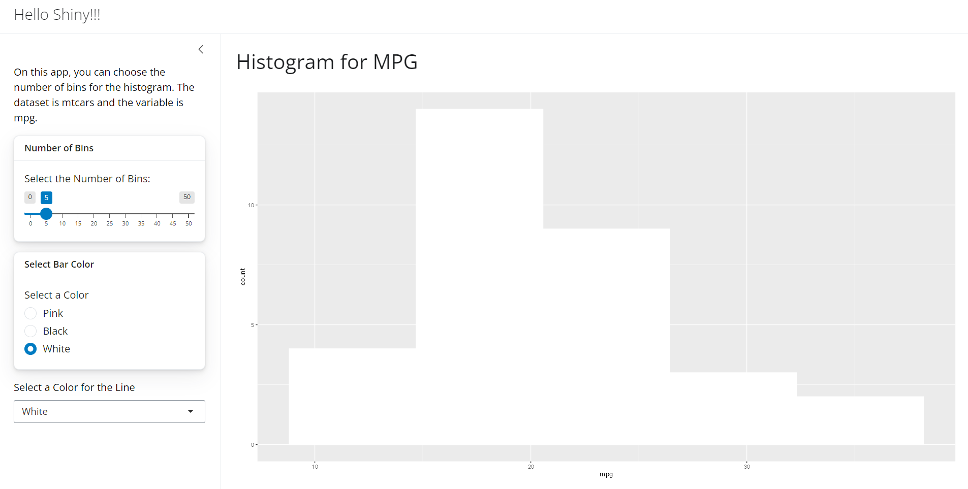
To Recreate 2
File Name: shiny_app_histogram_2

